Slide 1
AJAX and further learning

Slide 2
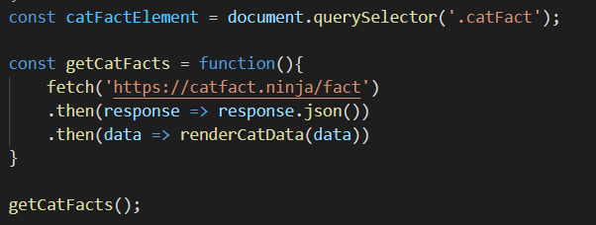
Let’s see the cat facts:
We will use this API’s url to get data: https://catfact.ninja/fact
To get data using AJAX best practice using js would be by using fetch:
Fetch(url).then(return json).then(do something with received data)

Slide 3
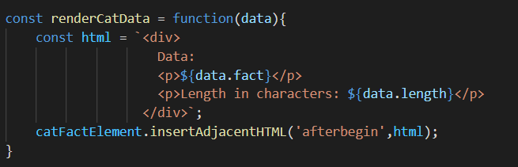
Let’s see the cat facts:
Now to show this on the screen we use the dom element
For selected dom element we call dom method insertAdjacentHTML

Slide 4
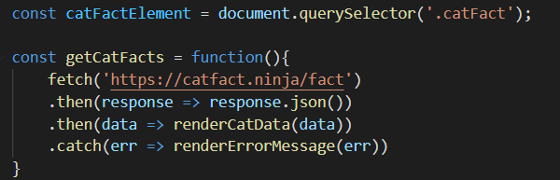
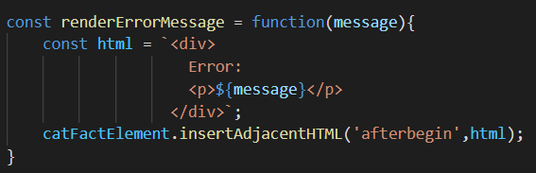
Error
What happens if we get error?
Maybe our URL is wrong, or our internet is not working properly
We need to use catch() keyword after then()

Slide 5
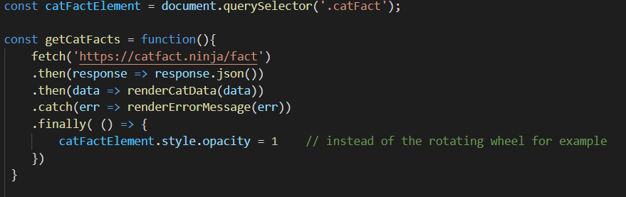
Finally
If we need to do something even if code fails, then best practice is to add finally keyword at the end of promise command chain.
‘Finally’ piece of code will always be executed, no matter If we have error or not!

Slide 6
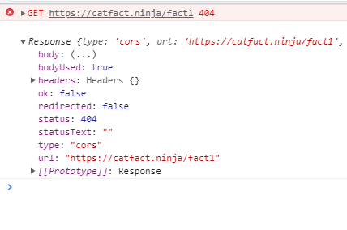

Error 404
If we want to display error 404 we need to first see if the response status is ok?
By default, 404 is acceptable, so we need to manually check it and throw an error
Whatever error we (or the program) throw, we must catch
Now let’s first add console.log for response,
to see what we get:

Slide 7
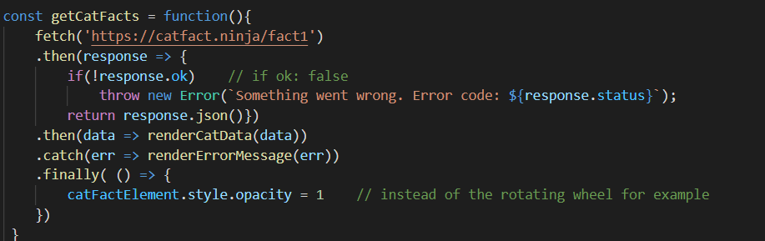
Error 404
If response is not ok, then we are adding throw new Error()
Throw means - I am creating error by myself and I’m telling program to act like it is an error and skip everything until the catch

Slide 8
Coding Challenge 1
Let’s try to make AJAX call using this url: https://www.boredapi.com/api/activity
Basically:
fetch json data
After receiving data use it to show on the screen
Activity: what you get from json
Type: what you get from json
Participants: what you get from json
Price: what you get from json
Link: what you get from json
(create function to show data on the screen)
Use catch and finally. Handle situation when response is not OK.

Slide 9
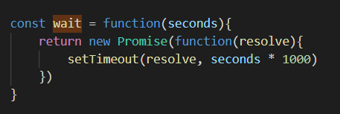
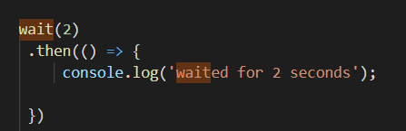
Now let’s see the Promise
We have already seen one Promise when using fetch()
Beside fetch() we can use promise to help us in many cases we need to wait for the result for some time. It promises it will give us result in future. So we wait for the result before showing it on the screen.
One such example is set timeout:

Slide 10
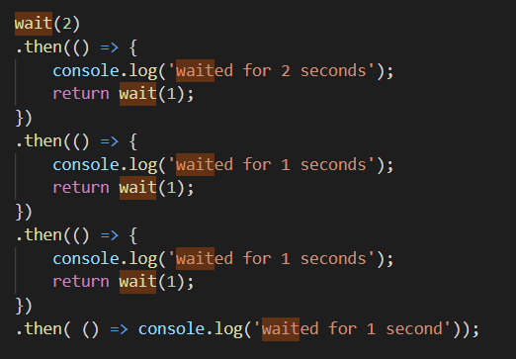
Promise one after another
You can execute multiple promises one after another
An example is:
Pay attention – after wait is called
there are no input parameters
inside the functions within then()

Slide 11
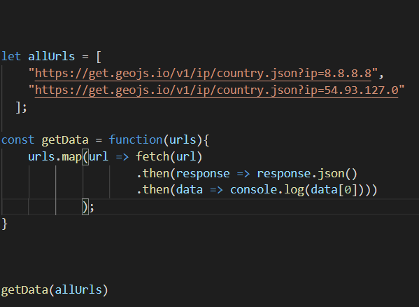
Let’s combine promise with map
It is possible to do many fetches withing with simple code
Use these URLs: https://get.geojs.io/v1/ip/country.json?ip=8.8.8.8
https://get.geojs.io/v1/ip/country.json?ip=54.93.127.0
Just remember the good old command map

Slide 12
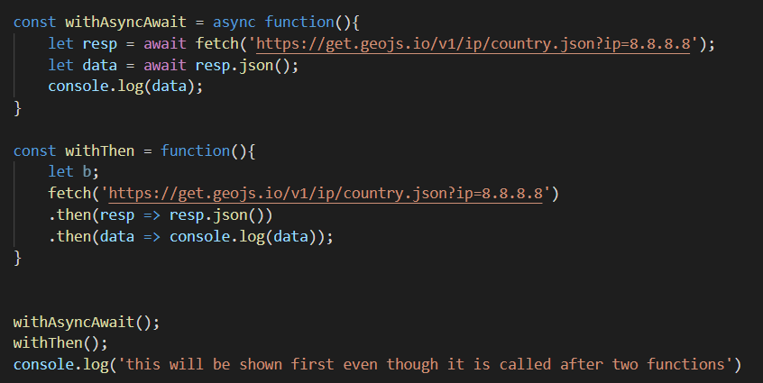
Async Await
To help us out the newer versions of JS have a very nice way of working with Asynchronous calls
Instead of calling many times then().then(), we can use async + await
These two functions
are absolutely the same:

Slide 13
Async Await
In the background the promise will be treated the same way as before
But we will have more clear code
Now it is important to remember:
Async should be added in the function definition
Await should be added when calling command that returns some promise!
Code inside of the function will not continue on, until line with await finishes it’s work.

Slide 14
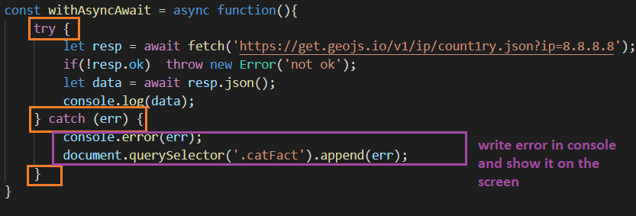
Async await and errors
When getting an error using Async-await, we cannot just use .catch() like before
We need to use try{} catch {} blocks in our code:

Slide 15
Coding challenge 2 or Homework
Add changes to Coding challenge 1 code
Use try{} catch {} block instead of .catch()
Use async + await instead of .then().then()

Slide 16
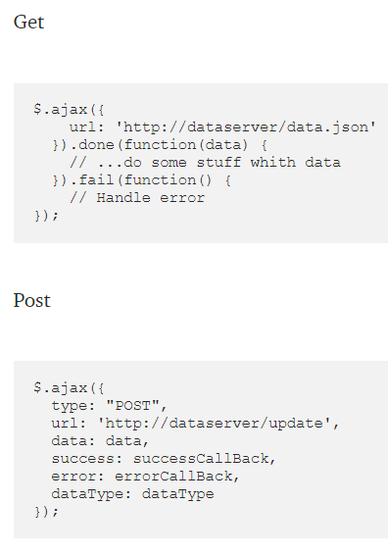
Further reading AJAX
There are many ways to use ajax calls
You can read https://javascript.plainenglish.io/comparing-different-ways-to-make-http-requests-in-javascript-39ab0f090788
Most popular one is using jQuery AJAX:
jQuery is a lightweight, "write less, do more", JavaScript library
It would be nice, if you have time, to learn how to use it.

